Slide 1
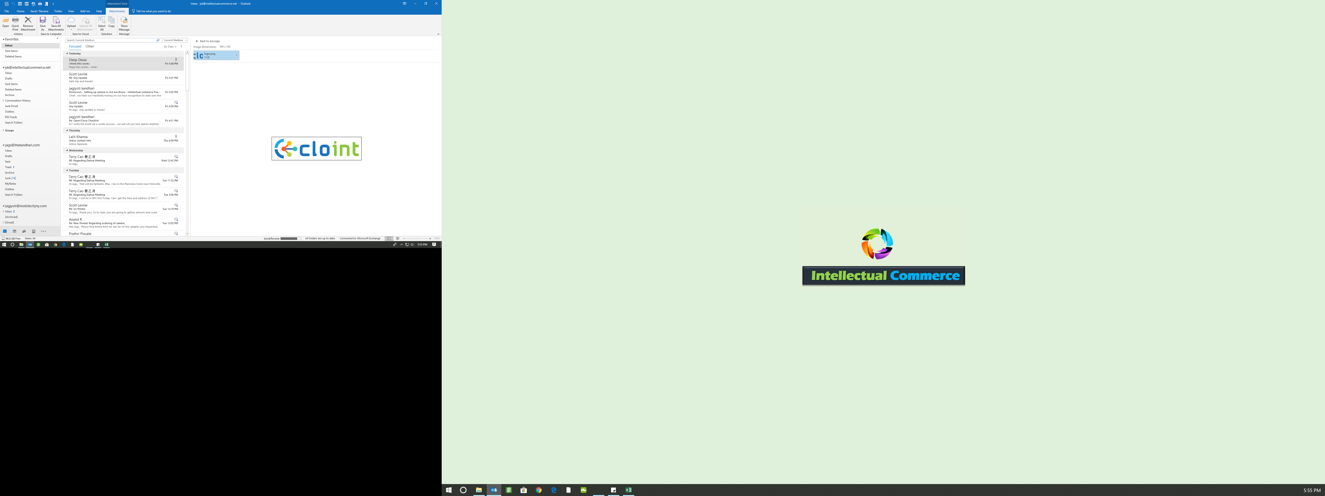
Wireless
Risk Management System
Potential Frauds
Transaction Discrepancy
Trend alters
Bot Rectified
Dealer Rectified

Slide 2
Audit – work flow
BOT PULL AND PROCESS INPUT REPORTS
Activation & device swap report ( BOT Processed)
ID scan
E-Signature
Vendor rebate History Report
DASHBOARD
Total transaction – NA/UP/DS
Potential frauds
Discrepancies – BOT Rectified / dealer Rectified
Trend alert
TEXT ALERTS
Text Pivot Points .
For the day before yesterday
Total transaction / PF/Dis/TA
DEALER AUDITORS TO EVALAUTE
Auditors or the SPOCS to check the potential frauds and trend alters and close them with revert on dashboard & rectify the discrepancies they are to closed
BOTs
To make rectifications on discrepancies
DASHBOARD ( UPDATE).
Total transaction – NA/UP/DS
Potential frauds – Confirmed Frauds / Clear/Open
Discrepancies – BOT Rectified / Dealer Rectified – Closed / Open
Trend alert - Fraud/Clear
MMS Alert
Day / YTD
Total Transactions – NA / UG / DS
PF – CF/Clr/Open
Dis – BOT - Closed/ Open
Dis – Dealer – Closed/Open
Trend Alert – Confirm Frauds / Clear
Employee/ Store ranking
( Name and Number)
Confirmed frauds
Total Discrepancies

Slide 3
Potential Frauds – QC Parameters.
No Usage .
<1 M Tenure , 5 Lines , No Social .
0 M Tenure , 0 line left , High end phone.
0 M , 1+ Line , High end Phone , Out Of State.
No Social , Out of State.
Same E mail ID Different account .
Same address different last name .
Same customer different stores in less than 1 month .
No ID Scan , High-end phone.
No ID Scan ,
Discrepancies – QC Parameters.
Not entered in RQ4
Duplicate on RQ4
Not on RMS
Name Mismatch
Term Mismatch
PTN Mismatch
Rectification on DAG – Anil will tell

Slide 4
Trend Alert – QC Parameters.
5+ line on employee
0 Tenure , Business account .
Store 2.5 time avg New Activation.
Same day , Multiple line , Same Customer , different employee .
Same customer 3+ Directship .
Employee with 1+ Not entered in RQ4
Store with 1+ duplicate .

Slide 5
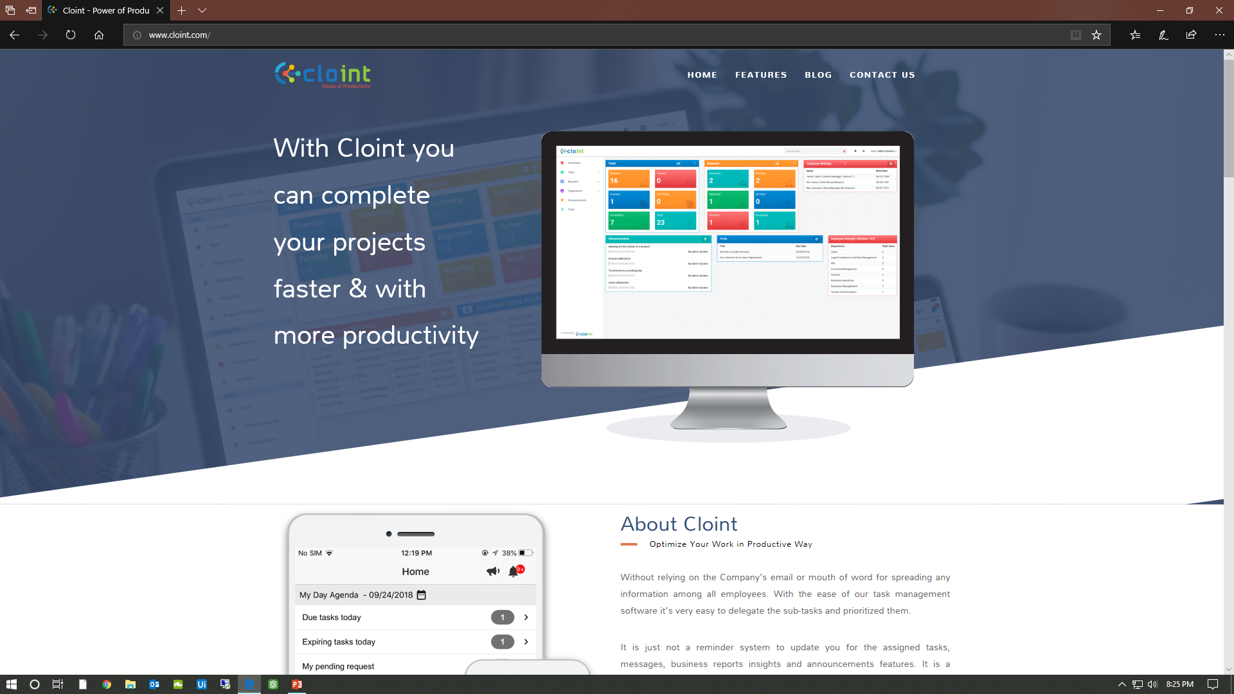

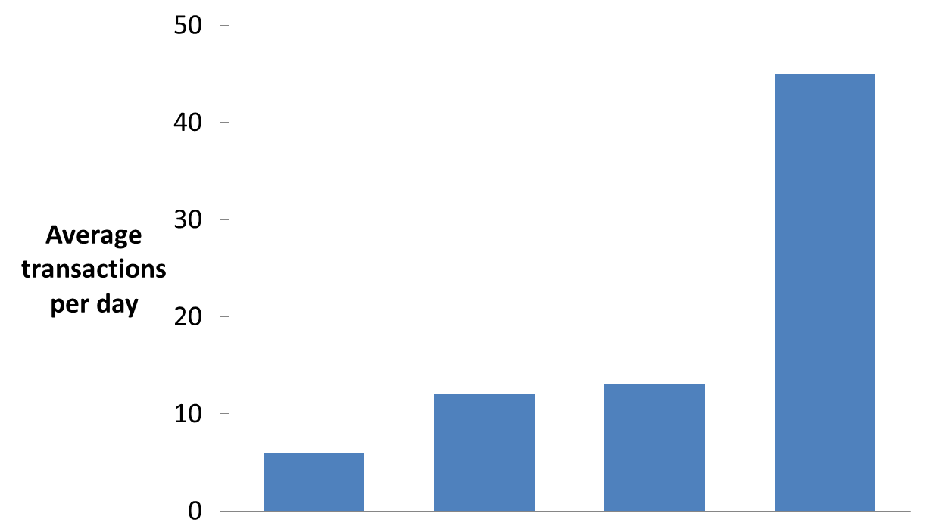
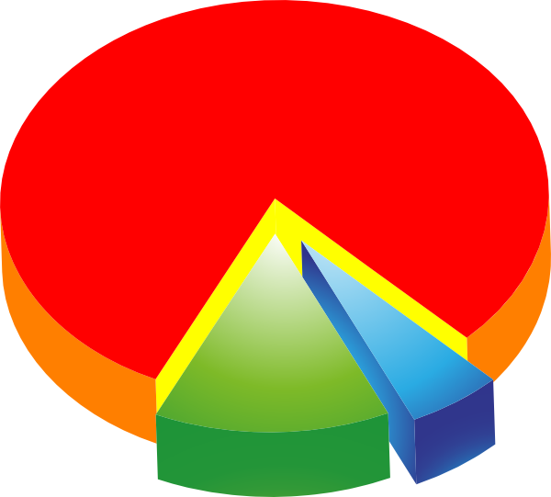



DASHBOARD – Mock up
Mobilecity – Risk Management Board
From : DD/MM/YYYY
TO : DD/MM/YYYY
Today MM/DD/YYYY
Today MM/DD/YYYY
STORE
TOTAL TRANSACTION NEW ACTIVATION UPGRADE DIRECTSHIPS
300
200
100
4
21
53
12
Sale MOO
Sale by Segment
Potential Frauds
Discrepancies
Trend Alerts
14
5
1
1
50
3
1
14
5
1
Open
Open
49
2
Confirmed
Cleared
Open
Open
BOT
Store
Open
Confirmed
Cleared
Open
Potential fraud / confirm frauds MOM
Confirmed / Trend Alerts MOM
Number
Store / Employee
PF/Dis/TA
Status
YTD/MTD/D
Number
Store / Employee
Sales Pivot
YTD/MTD/D
10
Store
PF
CF
D
10
Store
Id Scan
D
Sales Pivot :
No SSN
No Insurance
No Autopay
No Email
No ID Scan
No E-Signature

Slide 6

DASHBOARD – Mock up
Mobilecity – Risk Management Board
From : DD/MM/YYYY
TO : DD/MM/YYYY
T PF/DIS/TA TAG
T TAG - CAT
Today MM/DD/YYYY
Today MM/DD/YYYY
STORE
 |  |  |  | D | A | G
 |  |  |  | R | Q | 4
PF Tag | Trend alert tag | PF/TA Status | Discrepancy Tag | Discrepancy Status | Auditor Comment
 |  | OPEN CF CLEAR |  | Open Close

